Slide 1
DatasetRadar
Auto-discovering which public datasets news & journal articles cite —
live, without anyone manually tagging anything.
Product Demo · Captured from a running instance

Slide 2
What it is
• Watches a set of news/journal websites and scrapes new articles as they publish.
• Runs each article through an LLM detection pass that identifies which datasets, surveys, or reports it mentions (e.g. “NFHS-5”, “National Family Health Survey”) — no manual tagging.
• Extracted names are grounded against a dataset registry by embedding similarity, so paraphrases resolve to the same canonical dataset instead of creating duplicates.
• Detections are confidence-gated: high-confidence hits auto-accept, medium-confidence hits wait in a human Review Queue, low-confidence hits are discarded.
• Produces a live, queryable index of who is citing which dataset, where, and how often — plus a natural-language Ask interface with cited answers.
DatasetRadar — Product Demo
2

Slide 3
Tech Stack
Frontend
React 18 + React Router + TanStack Query, Vite, Tailwind CSS
Backend API
FastAPI, SQLAlchemy 2.0, Alembic migrations, Pydantic v2
Database
PostgreSQL 16 + pgvector (article & dataset embeddings)
Task queue
Celery workers + Celery Beat, backed by Redis
Scraper
httpx + BeautifulSoup + lxml, Playwright for JS pages, tenacity retries
Dataset detection
LLM extraction (Ollama via LangChain), grounded against the registry by embedding similarity
RAG Q&A
Natural-language question → embedding search over articles → cited answer (POST /api/v1/search/ask)
Deployment
Docker Compose — dev stack (live reload) + prod stack (Nginx, resource limits, internal-only db/redis)
DatasetRadar — Product Demo
3

Slide 4
Core Workflow
1
Add a source
An operator adds a website to watch in URL Manager, with a scrape frequency.
2
Scrape on schedule
Celery Beat triggers the scraper; results land in Scrape Logs with per-run health.
3
Detect & gate
The LLM pass extracts dataset mentions. High-confidence hits auto-accept; medium-confidence hits go to the Review Queue.
4
Review
A human accepts/rejects queued mentions, optionally asking the LLM for a second opinion.
5
Explore & ask
Trending Datasets and Summary show what's being cited; Ask answers plain-language questions with citations.
DatasetRadar — Product Demo
4

Slide 5
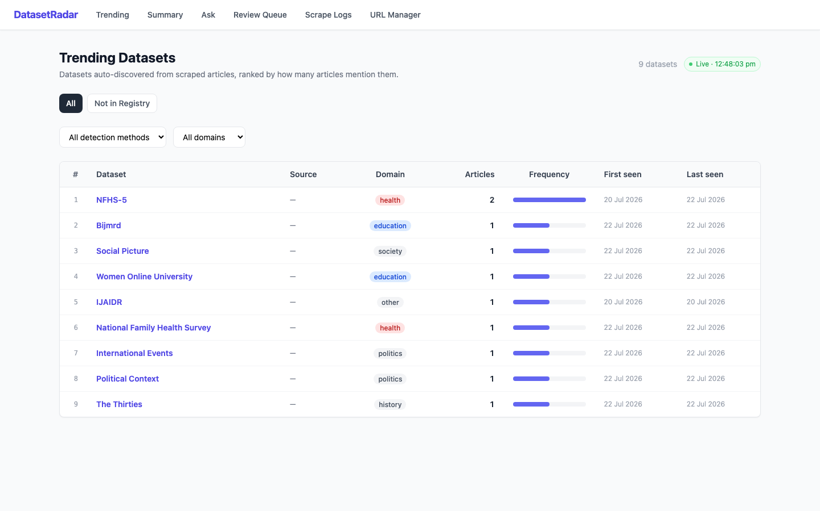
Trending Datasets
The default landing page. Ranks every auto-discovered dataset by how many articles mention it, with first/last-seen dates and a per-domain filter (health, education, politics...). The “what's hot right now” view.
DatasetRadar — Product Demo
5

Slide 6
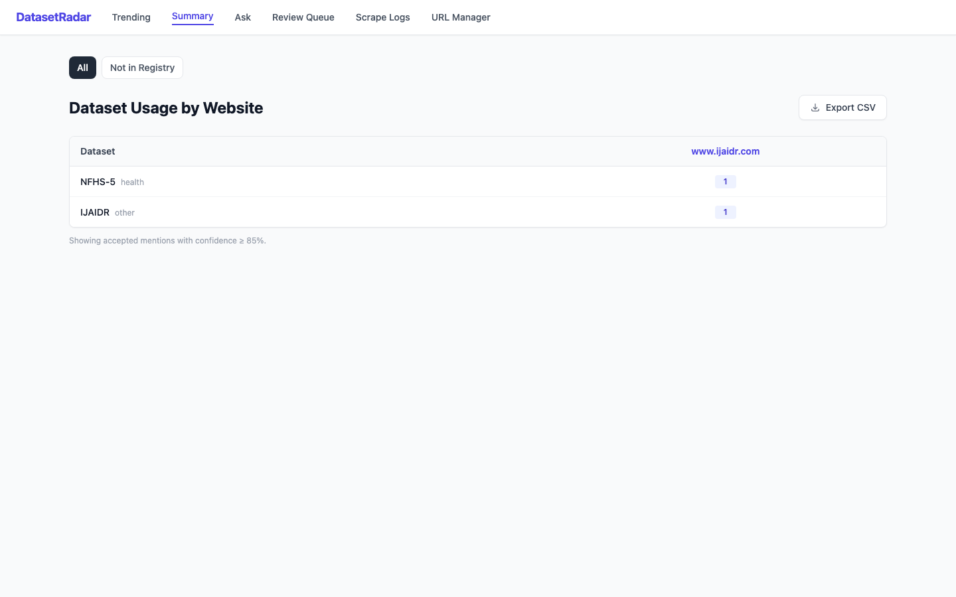
Summary — Dataset Usage by Website
A cross-tab of dataset × website, restricted to accepted mentions above the 85% confidence bar. Exportable to CSV for reporting.
DatasetRadar — Product Demo
6

Slide 7
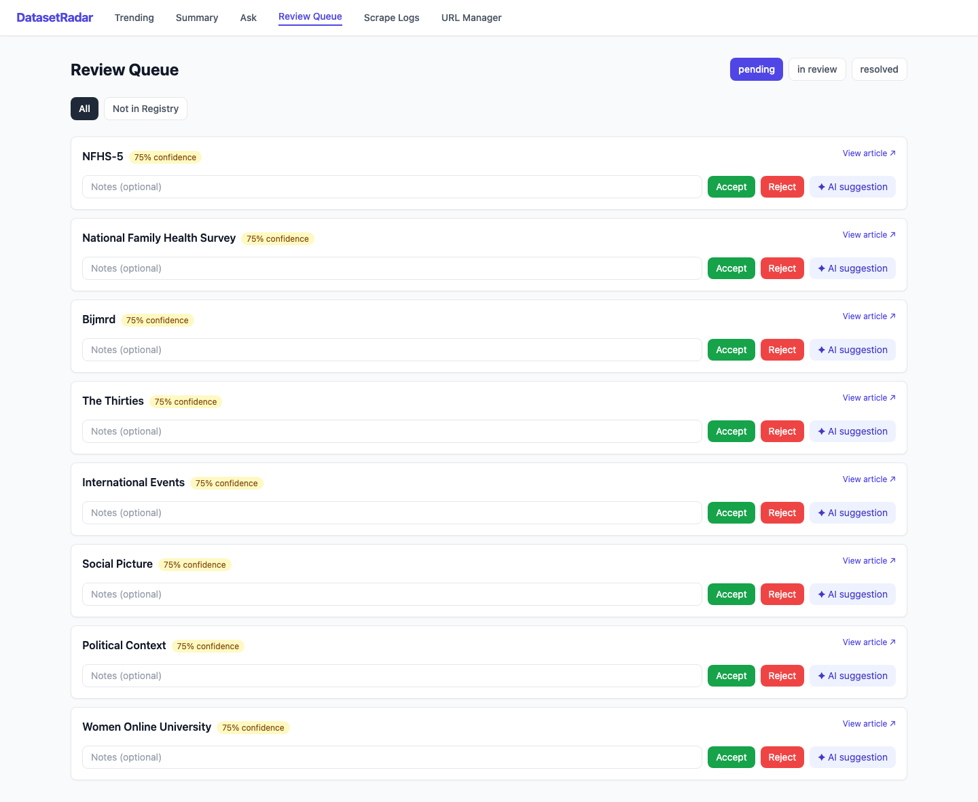
Review Queue — human in the loop
Every medium-confidence detection (75–85%) waits here instead of being auto-accepted. A reviewer can accept, reject, or ask the LLM for a second opinion before it counts as confirmed.
DatasetRadar — Product Demo
7

Slide 8
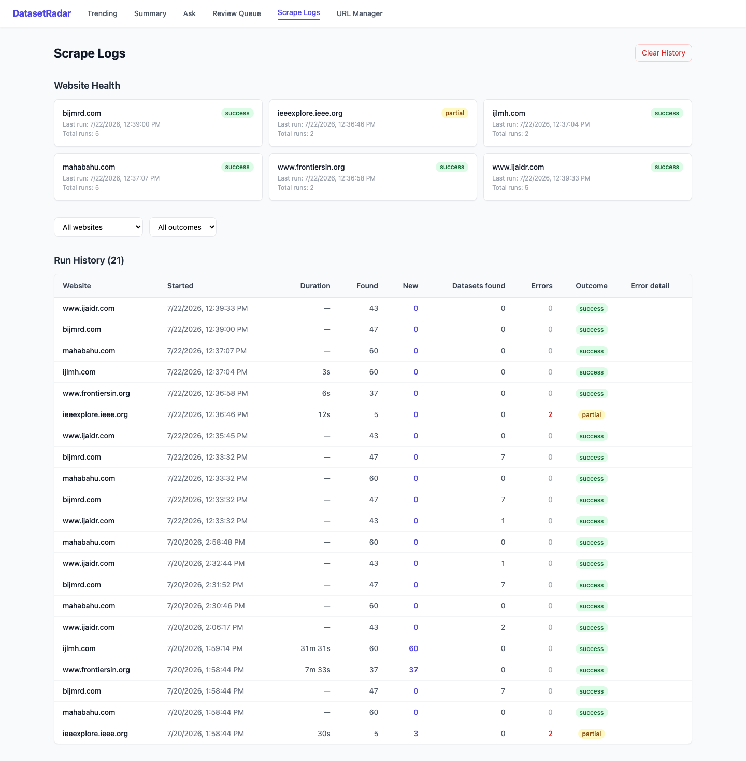
Scrape Logs — operational visibility
Per-website health cards (last run, total runs, success/partial/failure) plus a full run history: duration, articles found, new articles, datasets found, and errors.
DatasetRadar — Product Demo
8

Slide 9
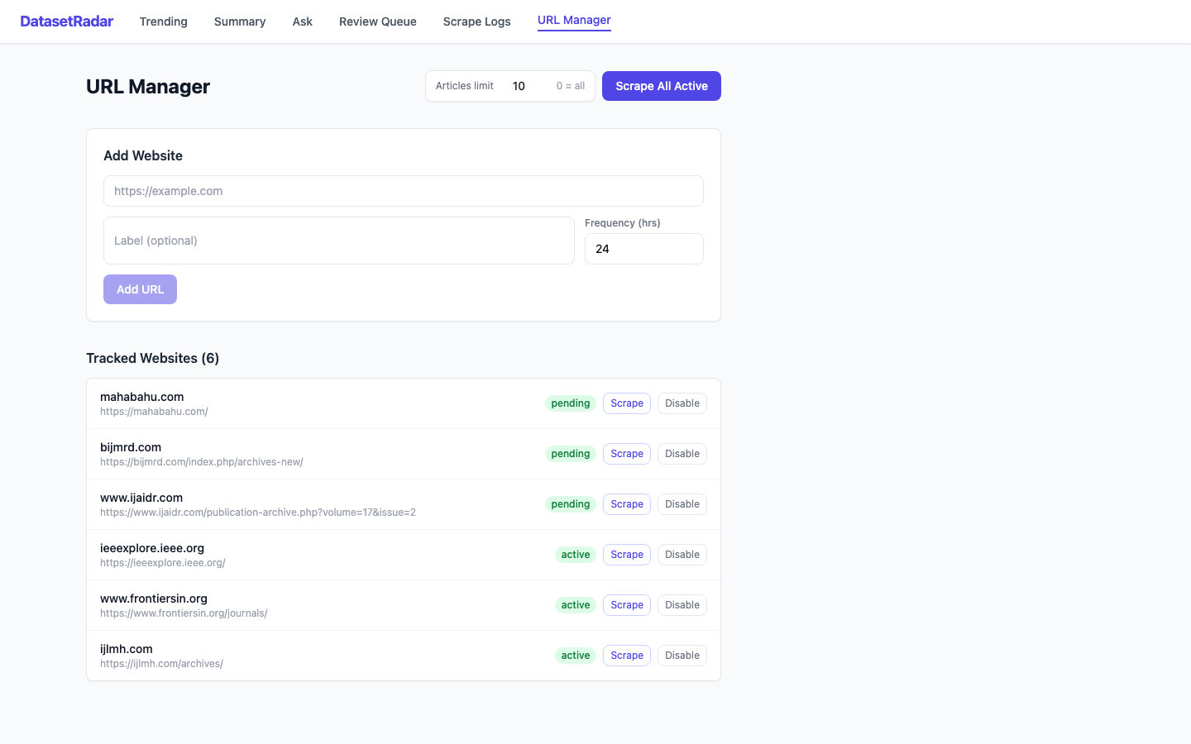
URL Manager — configure what gets watched
Add a new website with a scrape frequency, trigger an ad-hoc scrape, or disable a source. Six sources tracked in this demo instance.
DatasetRadar — Product Demo
9

Slide 10
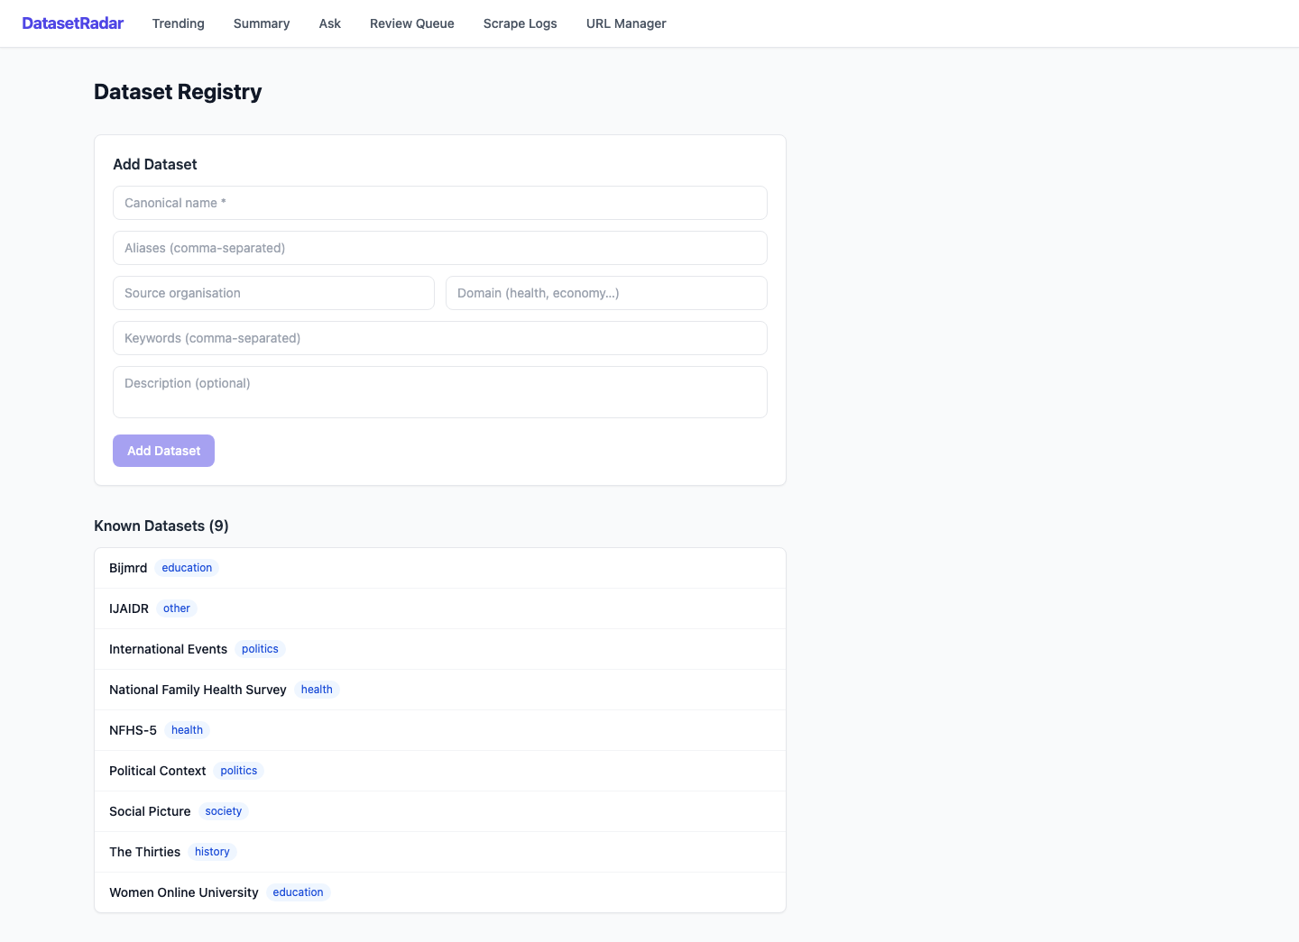
Dataset Registry — the canonical dataset list
The set of “known” datasets. New datasets also arrive bottom-up: the LLM auto-creates registry entries for datasets it finds that aren't registered yet.
DatasetRadar — Product Demo
10

Slide 11
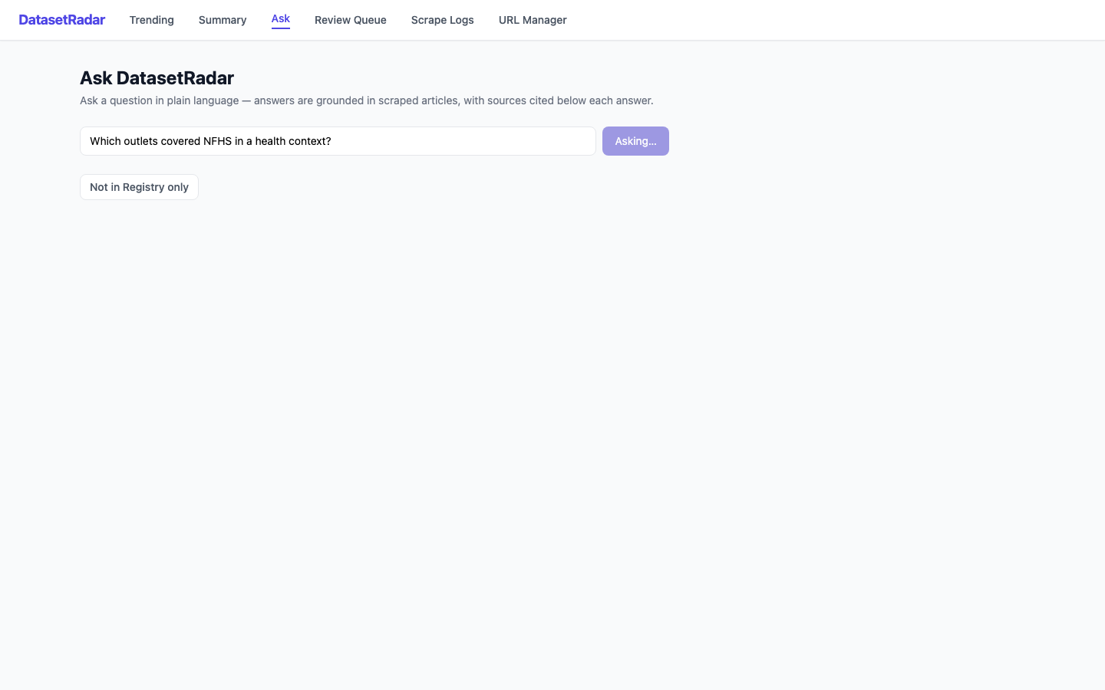
Ask — natural-language, cited Q&A over the corpus
Type a question in plain English and the RAG pipeline embeds it, retrieves the nearest matching scraped articles, and has the LLM synthesize a grounded, cited answer. (Captured mid-query — local Ollama inference runs on commodity CPU.)
DatasetRadar — Product Demo
11

Slide 12
What Makes This Different
• Confidence-gated, not all-or-nothing — detections route into auto-accept / human-review / discard.
• Open-ended discovery, deduped against the registry — the LLM pass isn't limited to a pre-registered dataset list, and extracted names are reconciled by embedding similarity to avoid duplicate entries.
• Fully local LLM — Ollama runs self-hosted (no per-request API cost or external data exposure), with OpenAI/Anthropic available as swappable alternatives via LLM_PROVIDER.
• Ask anything, not just browse a table — the RAG endpoint turns the scraped corpus into something queryable in plain language, cited back to source articles.
DatasetRadar — Product Demo
12

